Slide 1
SPECIAL EUROBAROMETER
ON CLIMATE CHANGE
93% of Europeans believe climate change to be caused by human activity
^{#EU2050}

Slide 2
SPECIAL EUROBAROMETER
ON CLIMATE CHANGE
85% of Europeans agree that fighting climate change and using energy more efficiently can create economic growth and jobs in Europe
^{#EU2050}

Slide 3
THE EU HAS SUCCESSFULLY DECOUPLED GREENHOUSE GAS EMISSIONS FROM ECONOMIC GROWTH
^{#EU2050}

Slide 4
SUSTAINABLE INVESTMENTS
At least 40% of European Fund for Strategic Investments infrastructure and innovation projects will aim to contribute to climate action
^{#EU2050}

Slide 5
EU’S ENERGY IMPORT DEPENDENCE WILL BE MASSIVELY REDUCED BY 2050
^{#EU2050}

Slide 6
THE RENEWABLE ENERGY REVOLUTION
The share of renewable energy in final energy consumption nearly doubled
^{#EU2050}

Slide 7
INVESTMENT IN THE EUROPEAN INFRASTRUCTURE NETWORKS: €42 BILLION BETWEEN 2021 AND 2027
With a target of 60% of its budget contributing to climate objectives
^{#EU2050}

Slide 8
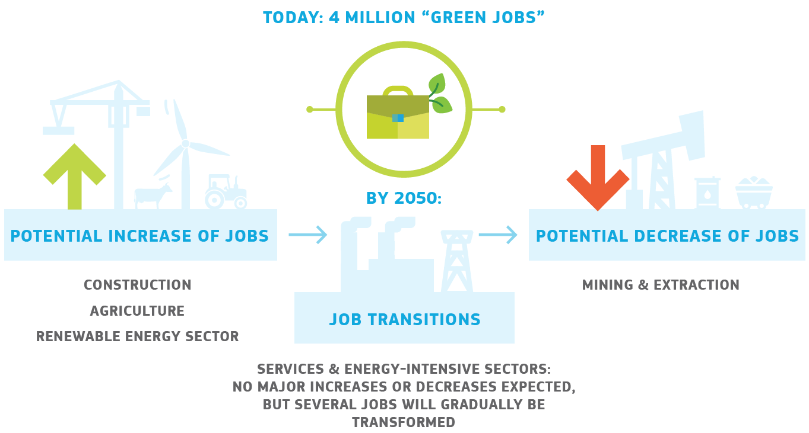
IMPACT OF TRANSITION TO CLIMATE NEUTRALITY ON JOBS
^{#EU2050}

Slide 9
SUSTAINABLE FINANCE
Sustainability considerations as part of financial decision-making
Fostering more sustainable private investments is one of the goals of the Capital Markets Union
Major investments are needed to deliver on climate, environmental and social sustainability targets
^{#EU2050}

Slide 10
CIRCULAR ECONOMY, A WIN-WIN SITUATION
Savings of €600 BILLION for EU businesses
Creation of 580,000 JOBS
Reduction of EU carbon emissions by 450 MILLION TONNES by 2030
^{#EU2050}

Slide 11
EU BIOECONOMY
EMPLOYMENT
jobs
TURNOVER
euros
VALUE ADDED
euros
^{#EU2050}

Slide 12
SPECIAL EUROBAROMETER
ON CLIMATE CHANGE
^{#EU2050}

Slide 13
SPECIAL EUROBAROMETER
ON CLIMATE CHANGE
^{#EU2050}

