Slide 1
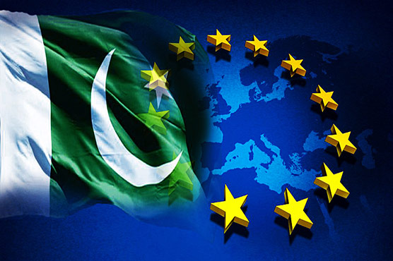
.
Preparation of a list of issues by the European Union
List of issues sent to the government of Pakistan
GSP+ Monitoring mission to Pakistan
The report is submitted to the European Parliament and to the Council
Discussion in European Parliament Committee of International Trade (INTA)
Presentation of the report to the Council in the Council Working Party on GSP
Definition of monitoring priorities
Consultations with civil society and international organizations by GSP Expert Group
Drafting of the GSP+ report
February 2020
GSP+ Timeline
The GSP+ grants full removal of tariffs on over 66 per cent of product categories for exports to the EU. These trade preferences are based on progress to be demonstrated with regards to the effective implementation of 27 international conventions on human and labour rights, environment protection and good governance.
Pakistan was awarded GSP+ status on 1 January 2014. Between 2013 and 2019, Pakistan’s exports to the EU increased 65.09%, while EU exports to Pakistan rose 44.43%.
GSP+ monitoring cycle is a continuous process and includes periodic bilateral discussions between the EU and the Government of Pakistan as well as other stakeholders.
February 2020
February 2020

