Slide 1

Relations

Slide 2
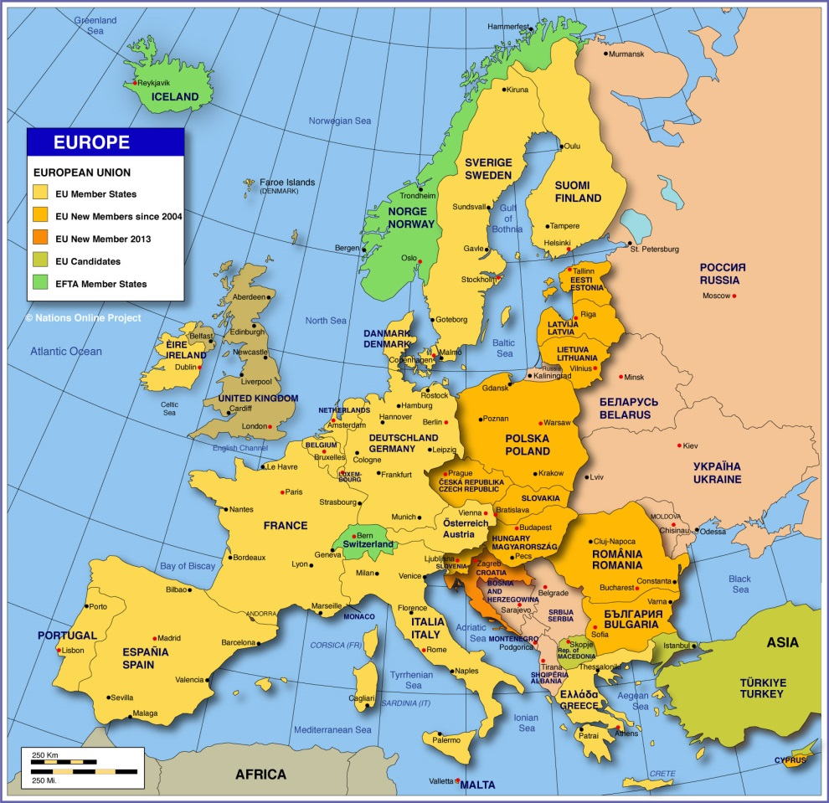
European Union - About
European Union is a political and economic union of 27 European countries (Excluding United Kingdom: Post Brexit)
A purely economic union European Economic Community (EEC), created in 1958 evolved into an organization spanning policy areas, from climate, environment and health to external relations and security, justice and migration named as European Union (EU) in 1993

Slide 3
European Union – Goals & Values
EU goal is:
To promote peace
Establish a unified economic and monetary system
Promote inclusion and combat discrimination
Break down barriers to trade and borders
Encourage technological and scientific developments
Champion environmental protection,
Promote goals like a competitive global market and social progress
The core values of EU are:
Human dignity
Freedom
Democracy
Equality
Rule of law
Human rights

Slide 4
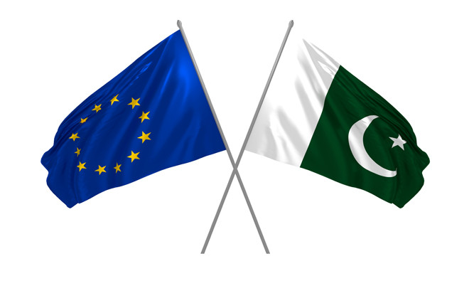
EU & Pakistan - History
European Union is a partner of Pakistan since 1962
The EU is represented in Pakistan by the Islamabad-based Delegation of the European Union
The European Union Delegation was established in Pakistan in 1985 with the objective of fostering closer and stronger ties

Slide 5
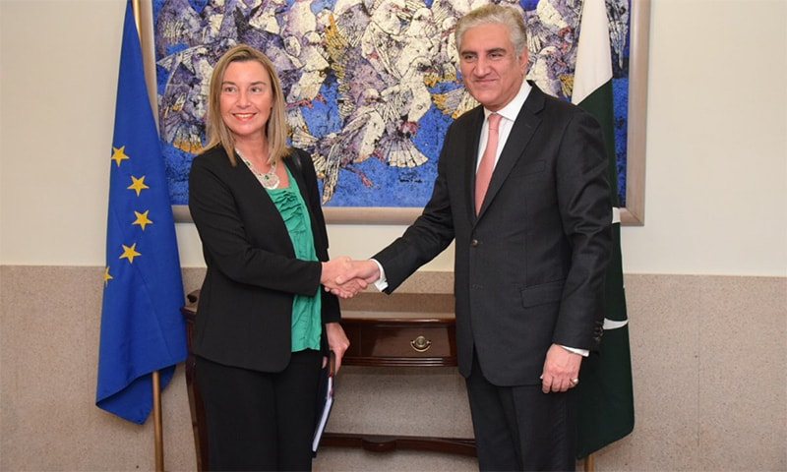
EU & Pakistan - Relation
The EU’s bilateral relations with Pakistan are guided by the EU-Pakistan Strategic Engagement Plan, signed in June 2019, and by the 2004 Cooperation Agreement on Partnership and Development

Slide 6
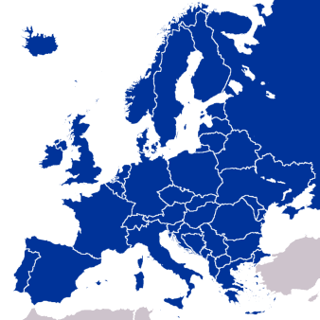


Economic Connectivity
The EU is Pakistan’s 2nd largest trading partner
The EU is Pakistan's main export destination
The EU accounts for 16% of Pakistan's total trade
The total EU’s FDI stock in Pakistan is 7.4%
35%
7.4%

Slide 7
Economic Connectivity
The EU
  Expects steady progress in Pakistan’s implementation of its commitments under the GSP+ preferential trade regime
  Encourages a further diversification of bilateral trade
Improved transparency of the business climate could further increase EU investments in Pakistan

Slide 8

Observation Missions
The 2018 EU Election Observation Mission was the fourth consecutive such mission from the EU to Pakistan
The Missions recommendations contributes to the overall improvement of the legal framework for elections and the consolidation of democracy in Pakistan

Slide 9

Rule of Law and Human Rights
The EU looks to work with all stakeholders in Pakistan in order to:
  strengthen the rule of law
  promote and protect human rights, including freedom of expression and media, freedom of religion and women’s rights
The EU’s preferential trade regime with Pakistan, GSP+, directly promotes human rights and labour rights as well as good governance standards and environmental protection
At the multilateral level, the EU and Pakistan constructively cooperate in the Human Rights Council in Geneva

Slide 10



Security and Defence Cooperation
Pakistan is a key player in regional peace and stability
Ongoing EU – Pakistan security and defence cooperation includes annual dialogues on:
  Counter Terrorism Non-proliferation and Disarmament Military – to – Military Talks

Slide 11

Humanitarian Assistance
Pakistan has long hosted and supported millions of Afghan nationals
The EU advocates for a sustainable approach for their return in line with international commitments and human rights standards, aiming at
  a predictable
  safe
  orderly and dignified process

Slide 12



People-to-People Contacts
7,700 new visas were issued for students in 2017
+ 20% of visas more for students every year
Pakistan has for years been among the top ten partner countries benefitting from Erasmus Mundus exchanges

Slide 13



EU’s Support Leading to Concrete Results
Since 1991, the EU has provided €1.3 billion in cooperation assistance to support Pakistan in the fight against poverty and to contribute towards sustainable growth
For the 2014-2020 period, the amount available for bilateral cooperation with Pakistan is €603 million, focusing on three key sectors:
  Rural Development Rule of Law and Human Rights Education and Vocational Training

Slide 14






The EU’s engagement in Pakistan is helping
45 million of Pakistan’s poorest out of poverty
> than 4.5 million children and pregnant and lactating women and children to receive nutrition support for the period 2019-2021
young people to have access to 1,200 enhanced, standardised training courses
37 police stations now have specific contact points for women
rural populations to benefit from specific support programmes (€180 million provided via national non-profit organisations)
225,000 people in Pakistan to benefit from technical and vocational educational training (€132 million provided)

Slide 15





FIND US ONLINE
@EUPakistan
@Akaminara
@EUinPakistan
@eudelegationpakistan
EU Delegation to Pakistan
https://eeas.europa.eu/delegations/pakistan_en

