Slide 1
Introduction to China IPR SME Helpdesk
Naomi Saunders
13 May 2015

Slide 2
The China IPR SME Helpdesk
Information and services free of charge for European SMEs and intermediary organisations
Raising awareness and preparing SMEs for IPR issues in China, Hong Kong, Macao and Taiwan
Business-focused and practical first-line advice encouraging proactive IPR protection
Delivering IPR business tools, self-help solutions and dedicated helpline
Enabling SMEs to make informed IPR decisions (protection, enforcement and IP management)

Slide 3
The China IPR SME Helpdesk
Project co-funded by the European Commission (DG GROW) to provide free services to European SMEs and intermediaries
Since 2008 implemented by the European Union Chamber of Commerce in China and Development SOLUTIONS. Now additional partner, Europe Business Network, joined the consortium
Since 2014 project scope includes Hong Kong, Macao and Taiwan – research phase
In 2015-2017 aim to increase outreach and activity in Hong Kong, Macao and Taiwan to generate enquiries

Slide 4
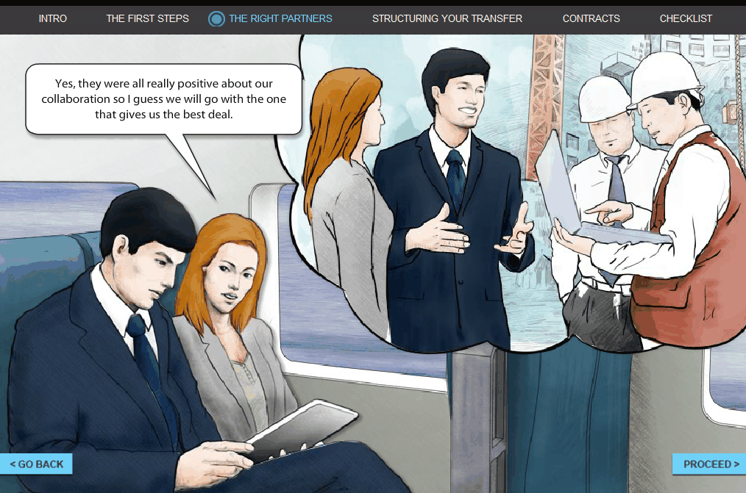
Helpdesk services at a glance
Enquiry Helpline
Training Workshops
& Live Webinars
Website & Blog
E-learning & Business Tools
IP Guides & Newsletters
4
Notes:
HELPDESK INTRO:
For those of you who are not already familiar with The China IPR SME Helpdesk, we are a project funded by the European Union, our services are free to European SMEs. We provide jargon-free, first-line, confidential advice on intellectual property issues in China to European SMEs.
Our services include:
Enquiry helpline which allows you to ask us an IP related question and receive a reply within 3 days; include ways to contact
Training events which are held throughout the year across Europe and China;
We provide IP materials such as guides, newsletters, case study catalogue, which are all available for download from our website where you can also find interactive E-learning modules, a news section and information on upcoming events.
You can also connect with us on social media sites such as Facebook, Twitter and LinkedIn to receive updates on our events and new features.

Slide 5
Enquiry Helpline
IPR one-to-one consultations: E-mail, telephone,
face-to-face, clinics at events, website live chat
function
First-line advice on China countries IPR matters
Confidential
Delivered by in-house IP Business Advisor with legal background
Available for EU SMEs and SME intermediaries
question@china-iprhelpdesk.eu
+86 (10) 64620892
Notes:
You can either phone, email or visit the Helpdesk offices in Beijing for tailored advice related to your IPR queries. Whether you are planning to enter the market in China, or have encountered an infringement coming from or related to China, your query will receive a confidential response from our experts within three working days.
The Helpdesk experts can assist and advise you on:
• Protecting your IPR when dealing with business partners and distributors
• Sourcing in China
• Trade fairs in China
• Registering your IP in China
• How to incorporate an effective IPR strategy into your business decisions
• R&D and product development
• Finding a lawyer that suits you
• Enforcing your rights

Slide 6
Typical Enquiries
“How do we register our patent in China?”
“I have a trade mark registered in Europe. Is it valid in China?”
“What actions can be taken in case of copyright infringement?”
“How long does it take to resolve a trade mark dispute case? How much does it cost?
Notes:
Until now 100% of the enquires received by the Helpdesk relate to Mainland China. We aim in 2015 to increase the diversity of enquiries and hope to have

Slide 7
Expected Enquiries from Hong Kong, Macao and Taiwan
“I have a trade mark/patent registered in Hong Kong. Is it valid in Mainland China?”
“Can I register a trade mark in Hong Kong directly from Europe?
“How can I protect my products from counterfeiting
when selling through e-commerce?”
“How can I value my IPR portfolio to improve my position in a business negotiation?”
Notes:
Until now 100% of the enquires received by the Helpdesk relate to Mainland China. We aim in 2015 to increase the diversity of enquiries and hope to have enquiries from all regions this year. Of course IPR laws are more established and accessible in Hong Kong than Mainland China but this is not the only way we can help. As the economy becomes more knowledge driven in tangible assets become more relevant to aspects such as licensing and M&A. There are huge opportunities from Mainland SOEs required to buy technology and buying whole companies to get it. Hong Kong has a hawkers culture and the biggest new market is online shopping. Companies will ask how to protect online.

Slide 8
Guides and Articles
Library of publications:
IP specific guides, incl. patents & trade marks
Industry specific guides, incl. textiles, machinery, creative industries
How to guides, incl. trade mark search and e-commerce takedowns
Mainland China, Hong Kong, Macao and Taiwan Factsheets
Written by network of IP Experts
Article placement:
Over 50 articles available now for
IP publications and partner
magazines/newsletters
8
Notes:
There are 25 publications on different IP topics, such as trade marks, patents, trade fairs and many more, all available for free download from the website. The Helpdesk are continuously updating their materials to keep all of you up to date on the latest IP challenges. Some of the new features include:
A regional factsheet series which consists of factsheets on Mainland China, Hong Kong and Macao.

Slide 9
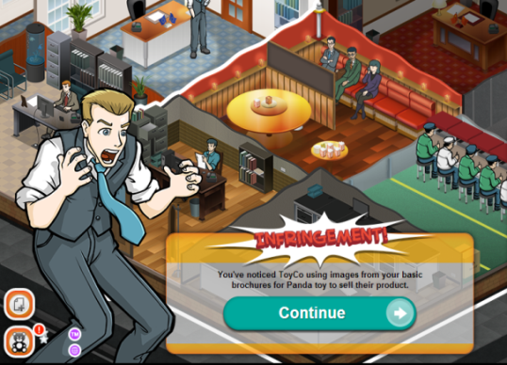
Training Workshops and Webinars
Trainings delivered across Europe, Mainland China, Hong Kong, Macao and Taiwan
Addressing general IPR and industry specific IPR matters
Trainings delivered in several languages by network of IP Experts
Tailored topics in multiple formats including Serious Game sessions
Free one-to-one consultations with expert speakers offered at every event
Webinars: Available to attend live or by accessing recordings online
Aim to deliver training in Hong Kong, Macao and Taiwan in 2015
Notes:
The Helpdesk arranges regular workshops in China and Europe which provide specific, focused advice to European SMEs. The Helpdesk works with a network of partners to hold specific industry and IPR area focused workshops.
Specific workshops include:
• Protecting your IP at trade fairs in China
• How to protect your domain name in China
• How to best use Customs to protect your IPR in China

Slide 10
Online Portal
Practical SME-focused content
E-learning modules including Mainland China, Hong Kong, Macao and Taiwan Comparison
Serious Game
Case study catalogue
FAQs
Event calendar
Latest blog posts
Helpdesk TV - videos
Recent redesign and new
live chat feature
Website: www.china-iprhelpdesk.eu
Blog: http://www.youripinsider.eu/
Notes:
Learn about China IPR using the portal’s online business tools. The Solution Centre shows you how to deal with commonly encountered IPR issues, while the Case Study Catalogue lets you learn the ‘do’s and don’ts’ of China IPR from the experience of real businesses. The Helpdesk’s E-learning Modules give online interactive training on how to use China’s IPR system to protect your company’s IPR.

Slide 11
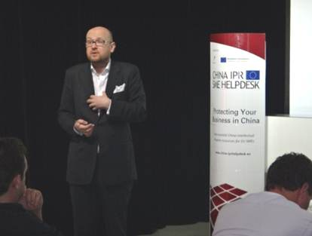
Network of Experts
Over 100 IP Experts from EU Members States and target regions
Must have strong knowledge of European IPR laws and a minimum of 3 years (junior expert) or 5 years (senior expert) experience in the target region
Contracted on short-term basis to draft publications and deliver trainings
Contribute to blog, biannual Policy Input Report and Helpdesk stakeholder meetings
Helpdesk provides quarterly E-bulletin for network members and inclusion on the ‘Our Experts’ section of the website

Slide 12
How We Can Work With You
Provide personalised advice to your member companies in cooperation with you
Organise joint training activities in person or via webinar platform
Provide training to visiting business delegations pre-departure (know before you go) or on arrival
Provide advance and/or on-the-ground support for trade fairs
Offer train-the-trainer sessions for internal staff
**Coming soon** accredited online train-the-trainer course
Receive monthly Partner E-bulletin and link on ‘Our Partners’ website page
Our network of partners is essential to reach European SMEs doing business in or with Mainland China, Hong Kong, Macao and Taiwan
Notes:
Embassies and consulates, chambers of commerce, trade promotion agencies, business incubators and any business related organisations

Slide 13
The China IPR SME Helpdesk provides free, confidential, business-focused advice to European Small and Medium Enterprises (SMEs) relating to IPR in China
Enquiry Helpline: question@china-iprhelpdesk.eu
Online Services: www.china-iprhelpdesk.eu
For more information about our services and how the China IPR SME Helpdesk can add value to EU SMEs, please contact:
Naomi Saunders naomi.saunders@china-iprhelpdesk.eu
Tel: +86 10 64622066 ext. 87

